Slide 1
Results presentation

Slide 2
Agenda
One/One DA learning matrix
Visualisation
Similarity

Slide 3
One by One matrixes

Slide 4
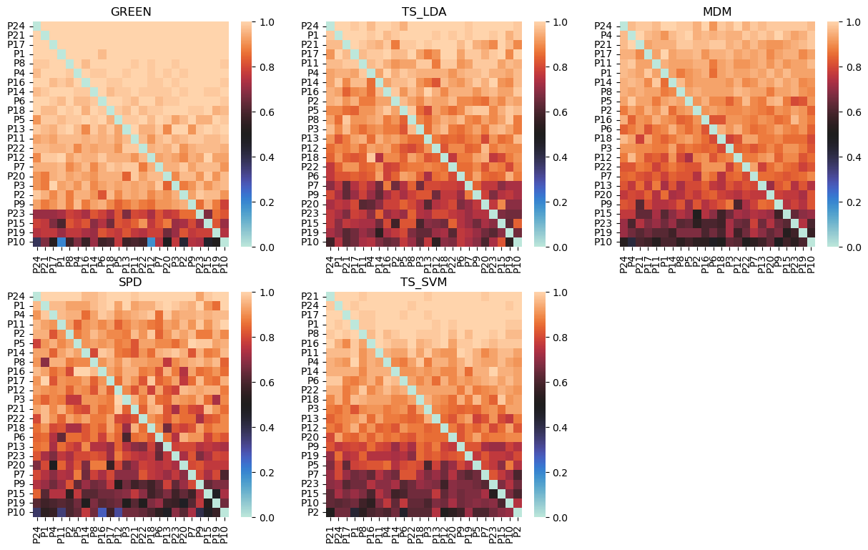
Code accuracy matrixes

Slide 5
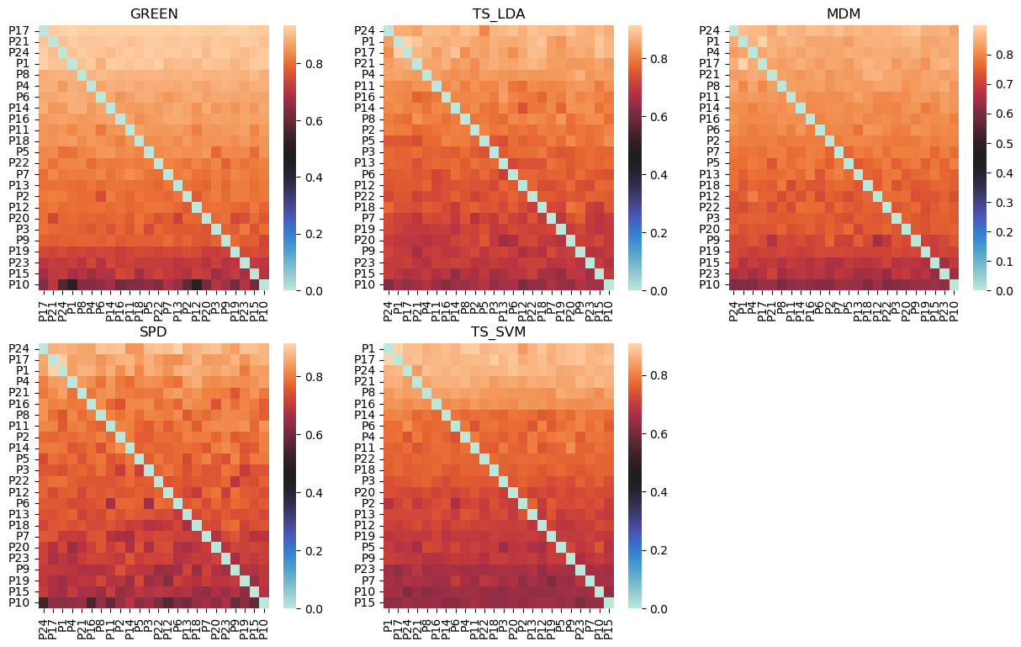
BITS accuracy matrixes

Slide 6
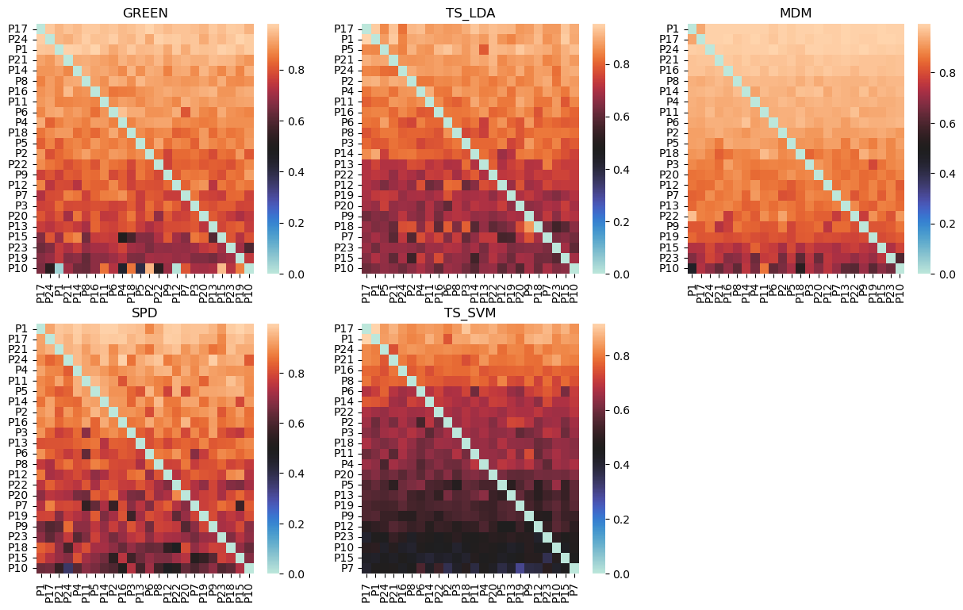
bits recall matrixes

Slide 7
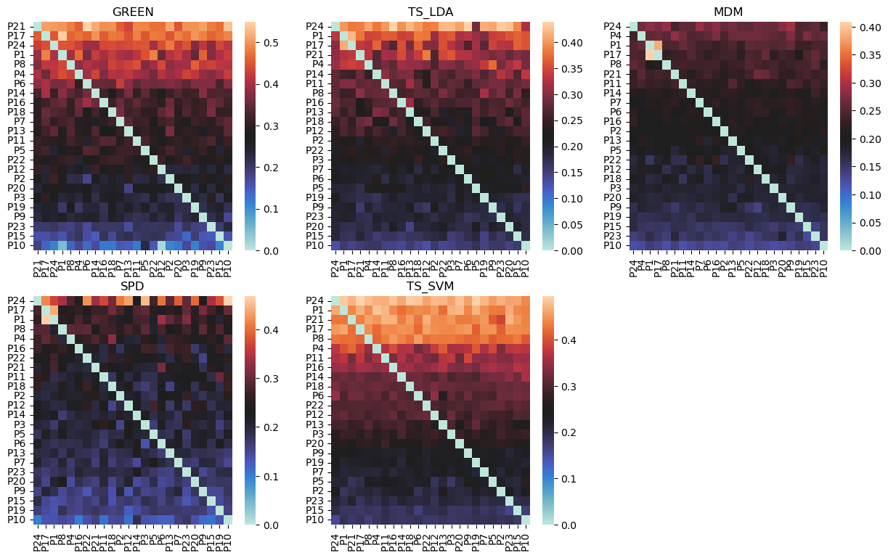
bits F1 matrixes

Slide 8
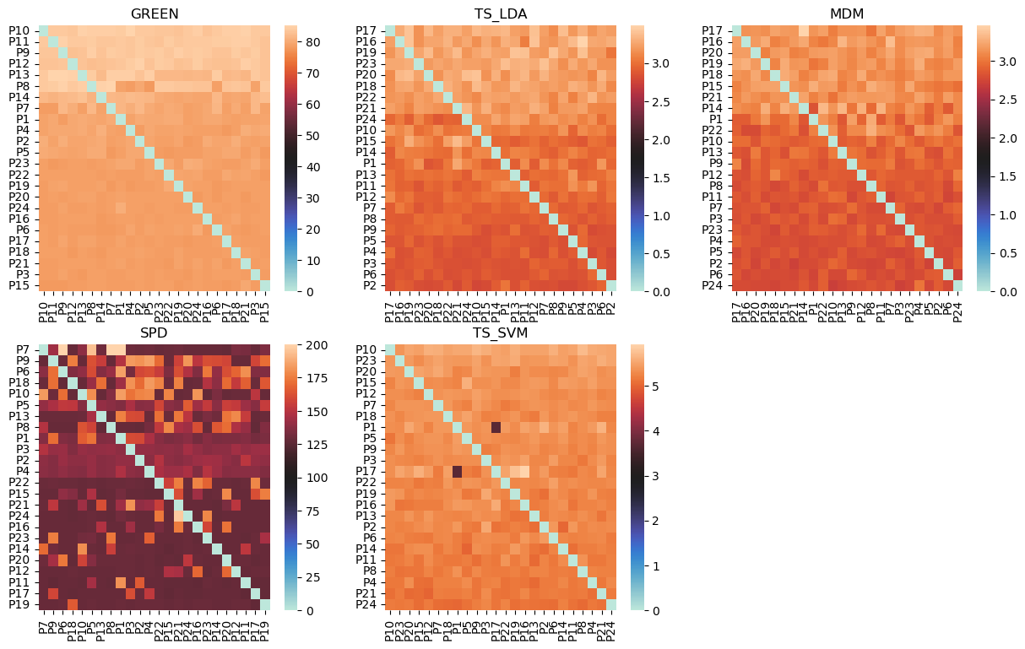
Training time matrixes

Slide 9
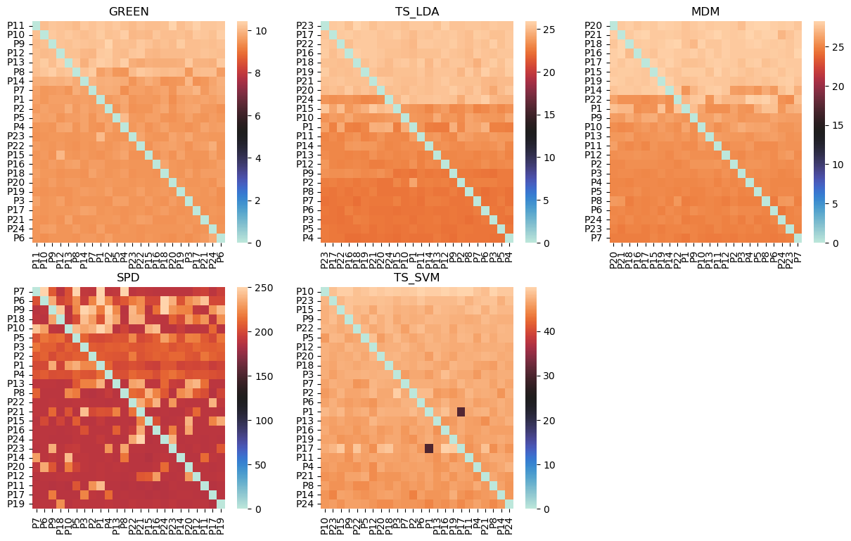
Code accuracy matrixes

Slide 10
Visualisation

Slide 11
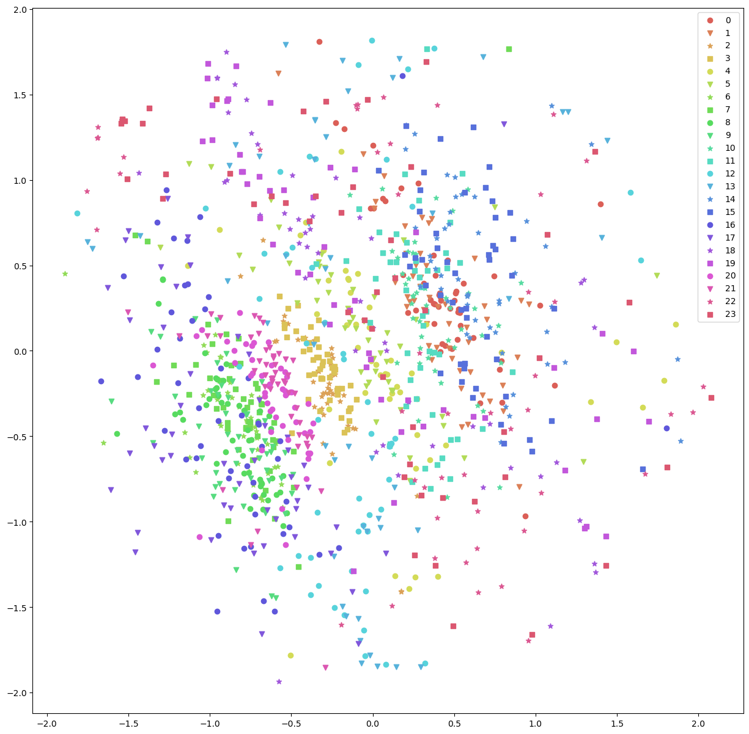
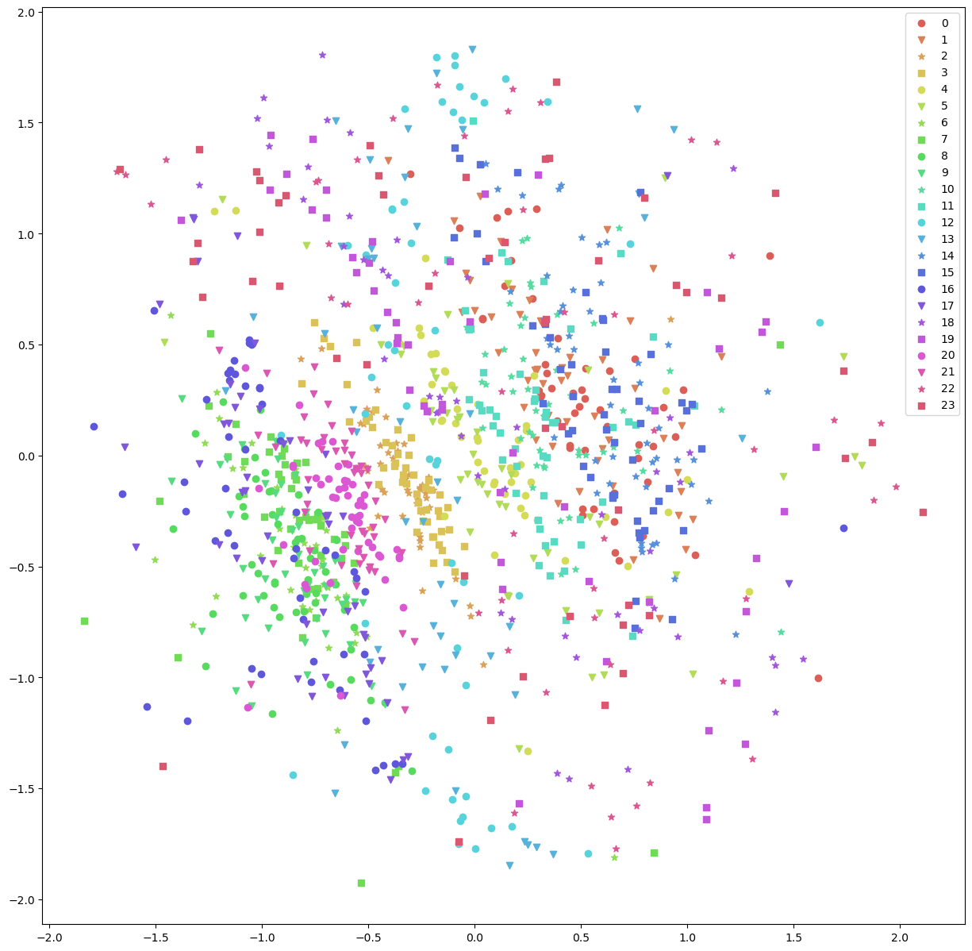
TSNE Representation
Label 1
Label 0

Slide 12
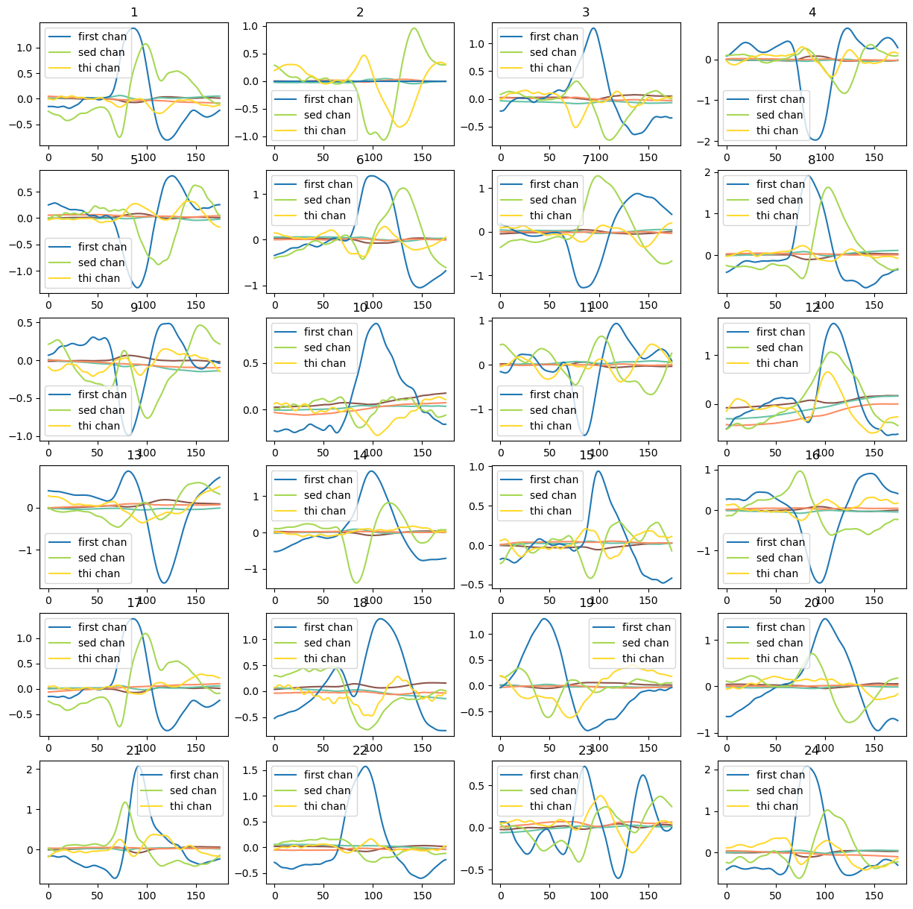
EPOCHs

Slide 13
Similarity

Slide 14
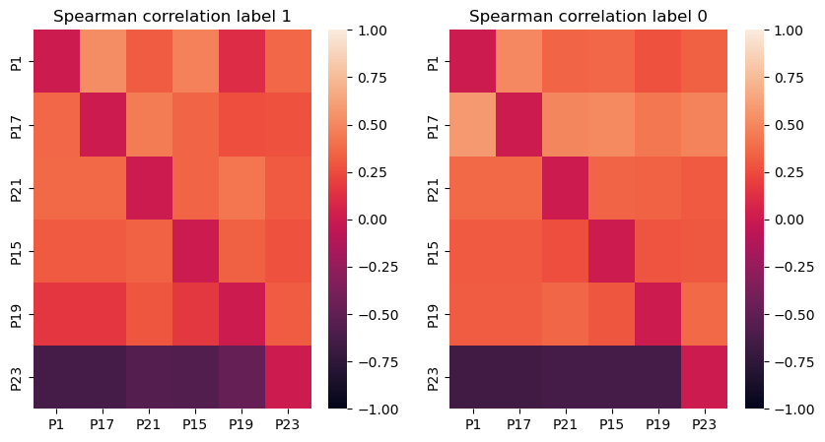
Spearman Correlation

Slide 15
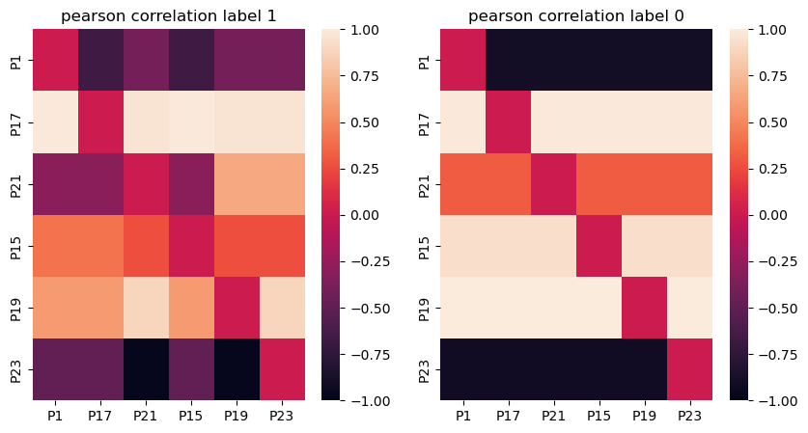
Pearson Correlation

Slide 16
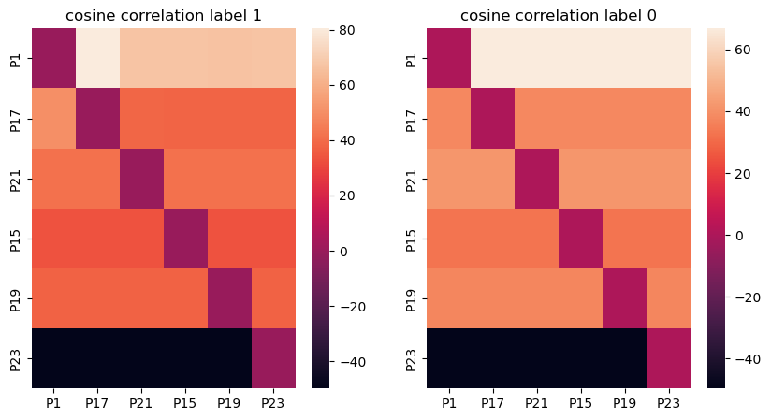
COSINE similarity

Slide 17
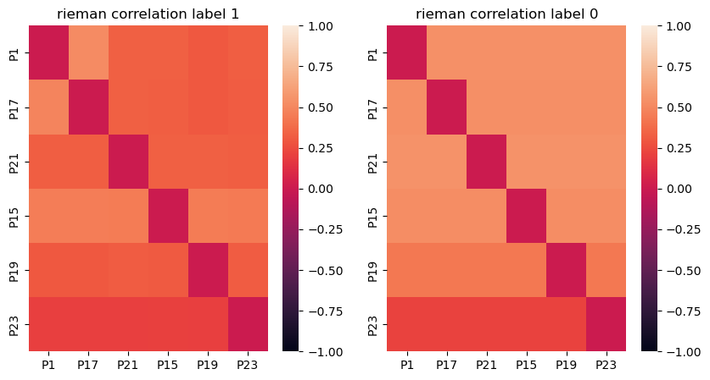
Riemannian distance

Slide 18
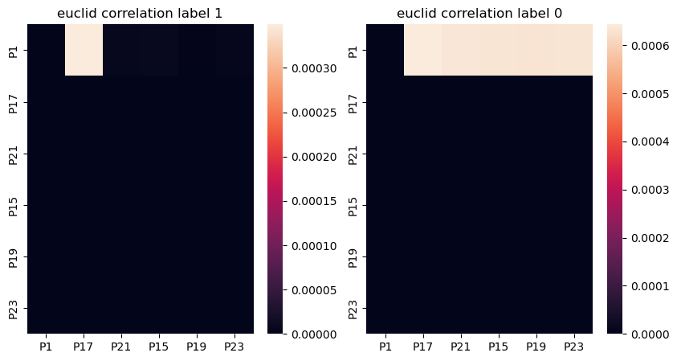
Euclidian distance

